Slide 1
Memory Management

Slide 2
Memory Management
Ideally programmers want memory that is
  large
  fast
  non volatile
Memory hierarchy
  small amount of fast, expensive memory – cache
  some medium-speed, medium price main memory - RAM
  gigabytes of slow, cheap disk storage
Memory manager handles the memory hierarchy

Slide 3
Memory Management
Task carried out by the OS and hardware to accommodate multiple processes in main memory
If only a few processes can be kept in main memory, then much of the time all processes will be waiting for I/O and the CPU will be idle
Hence, memory needs to be allocated efficiently in order to pack as many processes into memory as possible

Slide 4

Basic Memory Management
Monoprogramming without Swapping or Paging
Three simple ways of organizing memory
- an operating system with one user process

Slide 5
Memory Management
In most schemes, the kernel occupies some fixed portion of main memory and the rest is shared by multiple processes

Slide 6
Memory Management Requirements
Relocation
  programmer cannot know where the program will be placed in memory when it is executed
  a process may be (often) relocated in main memory due to swapping
  swapping enables the OS to have a larger pool of ready-to-execute processes
  memory references in code (for both instructions and data) must be translated to actual physical memory address

Slide 7
Memory Management Requirements
Protection
  processes should not be able to reference memory locations in another process without permission
  impossible to check addresses at compile time in programs since the program could be relocated
  address references must be checked at run time by hardware

Slide 8
Memory Management Requirements
Sharing
  must allow several processes to access a common portion of main memory without compromising protection
    cooperating processes may need to share access to the same data structure
    better to allow each process to access the same copy of the program rather than have their own separate copy

Slide 9
Memory Management Requirements
Logical Organization
  users write programs in modules with different characteristics
    instruction modules are execute-only
    data modules are either read-only or read/write
    some modules are private others are public
  To effectively deal with user programs, the OS and hardware should support a basic form of module to provide the required protection and sharing

Slide 10
Memory Management Requirements
Physical Organization
  secondary memory is the long term store for programs and data while main memory holds program and data currently in use
  moving information between these two levels of memory is a major concern of memory management (OS)
    it is highly inefficient to leave this responsibility to the application programmer

Slide 11
Simple Memory Management
The simpler case is when there is no virtual memory.
An executing process must be loaded entirely in main memory.
Although the following simple memory management techniques are not used in modern OS, they lay the ground for a proper discussion of virtual memory
  fixed partitioning
  dynamic partitioning
  simple paging
  simple segmentation

Slide 12
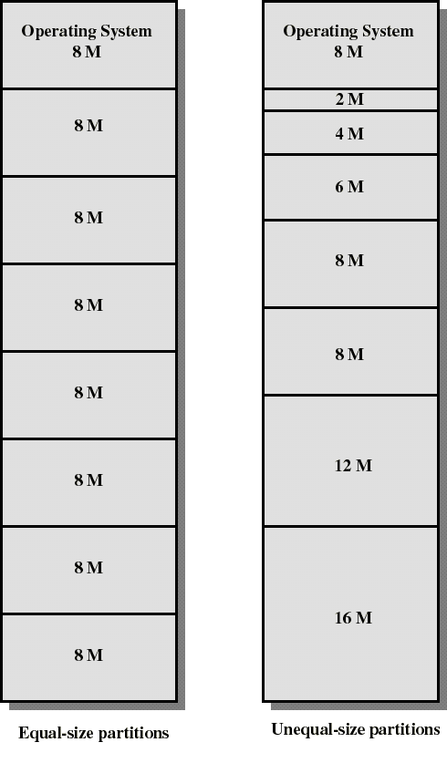
Fixed Partitioning
Partition main memory into a set of non overlapping regions called partitions
Partitions can be of equal or unequal sizes

Slide 13
Fixed Partitioning
any process whose size is less than or equal to a partition size can be loaded into the partition
if all partitions are occupied, the operating system can swap a process out of a partition
a program may be too large to fit in a partition. The programmer must then design the program with overlays
  when the module needed is not present the user program must load that module into the program’s partition, overlaying whatever program or data are there

Slide 14
Fixed Partitioning
Main memory use is inefficient. Any program, no matter how small, occupies an entire partition. This is called internal fragmentation.
Unequal-size partitions lessens these problems but they still remain...
Equal-size partitions was used in early IBM’s OS/MFT (Multiprogramming with a Fixed number of Tasks)

Slide 15
Placement Algorithm with Partitions
Equal-size partitions
  If there is an available partition, a process can be loaded into that partition
    because all partitions are of equal size, it does not matter which partition is used
  If all partitions are occupied by blocked processes, choose one process to swap out to make room for the new process

Slide 16
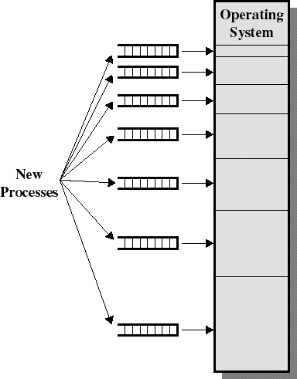
Placement Algorithm with Partitions
Unequal-size partitions: use of multiple queues
  assign each process to the smallest partition within which it will fit
  A queue for each partition size
  tries to minimize internal fragmentation
  Problem: some queues will be empty if no processes within a size range is present

Slide 17
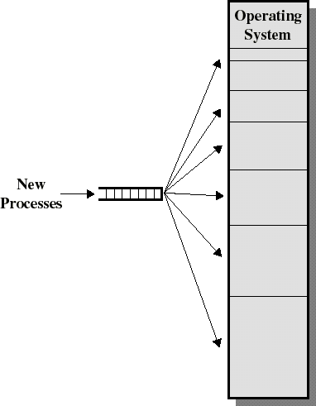
Placement Algorithm with Partitions
Unequal-size partitions: use of a single queue
  When its time to load a process into main memory the smallest available partition that will hold the process is selected
  increases the level of multiprogramming at the expense of internal fragmentation

Slide 18
Dynamic Partitioning
Partitions are of variable length and number
Each process is allocated exactly as much memory as it requires
Eventually holes are formed in main memory. This is called external fragmentation
Must use compaction to shift processes so they are contiguous and all free memory is in one block
Used in IBM’s OS/MVT (Multiprogramming with a Variable number of Tasks)

Slide 19
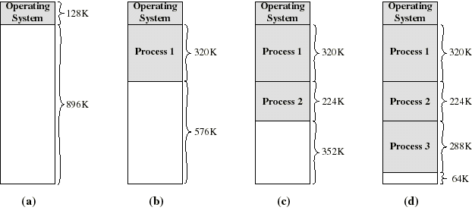
Dynamic Partitioning: an example
A hole of 64K is left after loading 3 processes: not enough room for another process
Eventually each process is blocked. The OS swaps out process 2 to bring in process 4

Slide 20
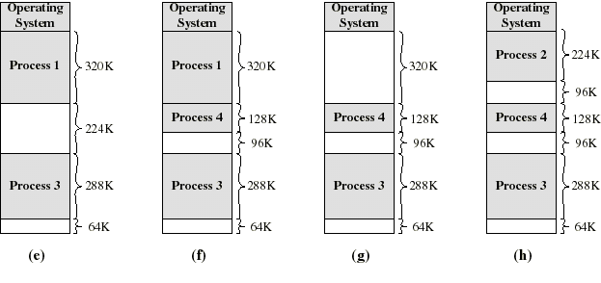
Dynamic Partitioning: an example
another hole of 96K is created
Eventually each process is blocked. The OS swaps out process 1 to bring in again process 2 and another hole of 96K is created...
Compaction would produce a single hole of 256K

Slide 21
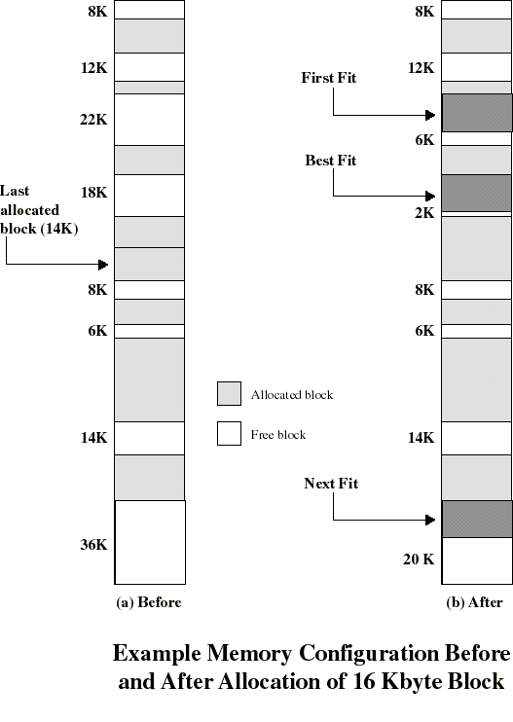
Placement Algorithm
Used to decide which free block to allocate to a process
Goal: to reduce usage of compaction (time consuming)
Possible algorithms:
  Best-fit: choose smallest hole
  First-fit: choose first hole from beginning
  Next-fit: choose first hole from last placement

Slide 22
Placement Algorithm: comments
Next-fit often leads to allocation of the largest block at the end of memory
First-fit favors allocation near the beginning: tends to create less fragmentation then Next-fit
Best-fit searches for smallest block: the fragment left behind is small as possible
  main memory quickly forms holes too small to hold any process: compaction generally needs to be done more often

Slide 23
Replacement Algorithm
When all processes in main memory are blocked, the OS must choose which process to replace
  A process must be swapped out (to a Blocked-Suspend state) and be replaced by a new process or a process from the Ready-Suspend queue
  We will discuss later such algorithms for memory management schemes using virtual memory

Slide 24
Relocation
Because of swapping and compaction, a process may occupy different main memory locations during its lifetime
Hence physical memory references by a process cannot be fixed
This problem is solved by distinguishing between logical address and physical address

Slide 25
Address Types
A physical address (absolute address) is a physical location in main memory
A logical address is a reference to a memory location independent of the physical structure/organization of memory
Compilers produce code in which all memory references are logical addresses
A relative address is an example of logical address in which the address is expressed as a location relative to some known point in the program (ex: the beginning)

Slide 26
Address Translation
Relative address is the most frequent type of logical address used in pgm modules (ie: executable files)
Such modules are loaded in main memory with all memory references in relative form
Physical addresses are calculated “on the fly” as the instructions are executed
For adequate performance, the translation from relative to physical address must by done by hardware

Slide 27
Simple example of hardware translation of addresses
When a process is assigned to the running state, a base register (in CPU) gets loaded with the starting physical address of the process
A bound register gets loaded with the process’s ending physical address
When a relative addresses is encountered, it is added with the content of the base register to obtain the physical address which is compared with the content of the bound register
This provides hardware protection: each process can only access memory within its process image

Slide 28
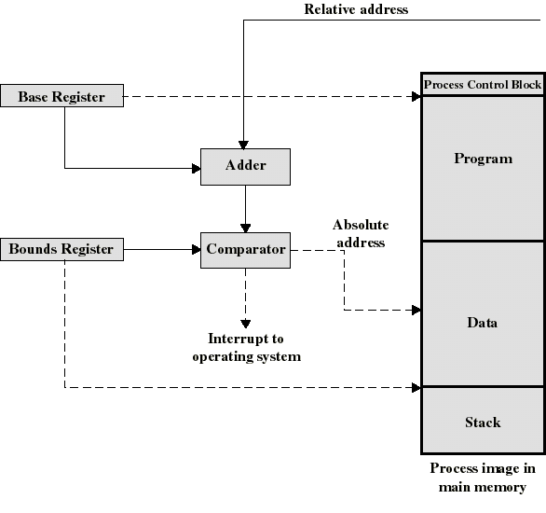
Example Hardware for Address Translation

Slide 29
Simple Paging
Main memory is partition into equal fixed-sized chunks (of relatively small size)
Trick: each process is also divided into chunks of the same size called pages
The process pages can thus be assigned to the available chunks in main memory called frames (or page frames)
Consequence: a process does not need to occupy a contiguous portion of memory

Slide 30
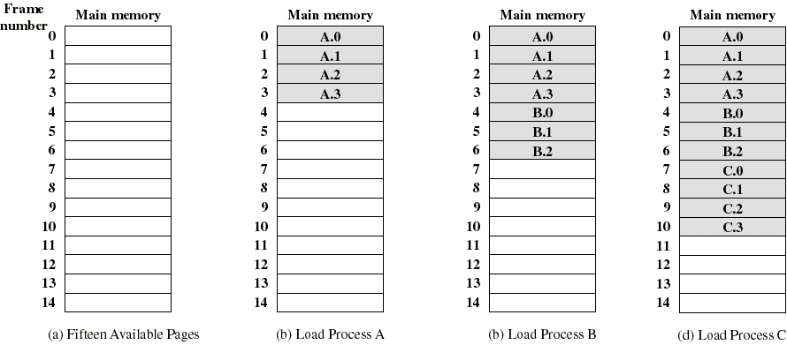
Example of process loading
Now suppose that process B is swapped out

Slide 31
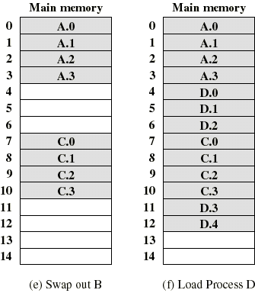
Example of process loading (cont.)
When process A and C are blocked, the pager loads a new process D consisting of 5 pages
Process D does not occupied a contiguous portion of memory
There is no external fragmentation
Internal fragmentation consist only of the last page of each process

Slide 32
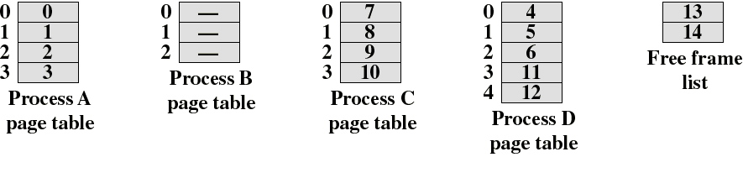
Page Tables
The OS now needs to maintain (in main memory) a page table for each process
Each entry of a page table consist of the frame number where the corresponding page is physically located
The page table is indexed by the page number to obtain the frame number
A free frame list, available for pages, is maintained

Slide 33
Logical address used in paging
Within each program, each logical address must consist of a page number and an offset within the page
A CPU register always holds the starting physical address of the page table of the currently running process
Presented with the logical address (page number, offset) the processor accesses the page table to obtain the physical address (frame number, offset)

Slide 34
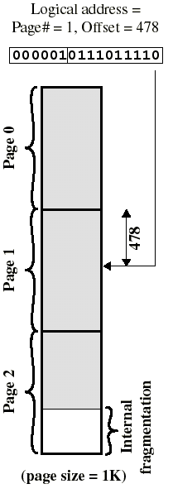
Logical address in paging
The logical address becomes a relative address when the page size is a power of 2
Ex: if 16 bits addresses are used and page size = 1K, we need 10 bits for offset and have 6 bits available for page number
Then the 16 bit address obtained with the 10 least significant bit as offset and 6 most significant bit as page number is a location relative to the beginning of the process

Slide 35
Logical address in paging
By using a page size of a power of 2, the pages are invisible to the programmer, compiler/assembler, and the linker
Address translation at run-time is then easy to implement in hardware
  logical address (n,m) gets translated to physical address (k,m) by indexing the page table and appending the same offset m to the frame number k

Slide 36
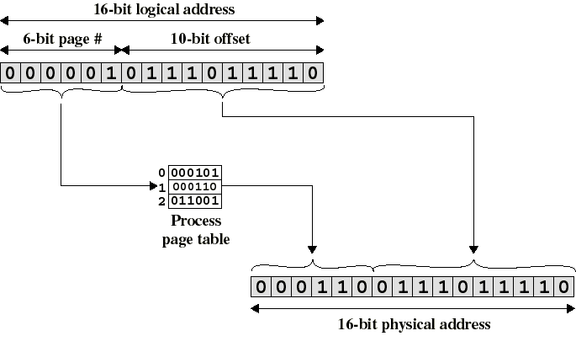
Logical-to-Physical Address Translation in Paging

Slide 37
Simple Segmentation
Each program is subdivided into blocks of non-equal size called segments
When a process gets loaded into main memory, its different segments can be located anywhere
Each segment is fully packed with instructs/data: no internal fragmentation
There is external fragmentation; it is reduced when using small segments

Slide 38
Simple Segmentation
In contrast with paging, segmentation is visible to the programmer
  provided as a convenience to organize logically programs (ex: data in one segment, code in another segment)
  must be aware of segment size limit
The OS maintains a segment table for each process. Each entry contains:
  the starting physical addresses of that segment.
  the length of that segment (for protection)

Slide 39
Logical address used in segmentation
When a process enters the Running state, a CPU register gets loaded with the starting address of the process’s segment table.
Presented with a logical address (segment number, offset) = (n,m), the CPU indexes (with n) the segment table to obtain the starting physical address k and the length l of that segment
The physical address is obtained by adding m to k (in contrast with paging)
  the hardware also compares the offset m with the length l of that segment to determine if the address is valid

Slide 40
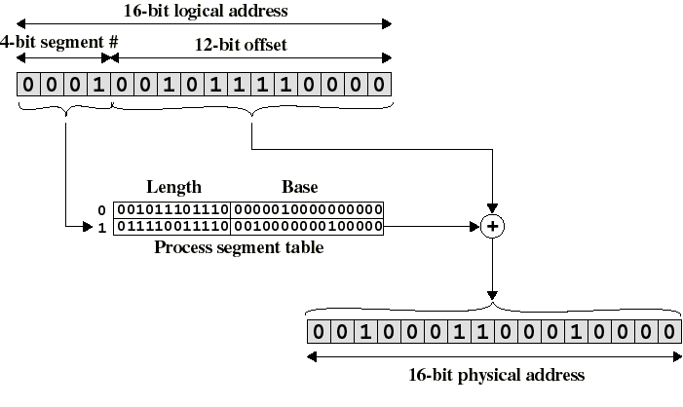
Logical-to-Physical Address Translation in segmentation

Slide 41
Simple segmentation and paging comparison
Segmentation requires more complicated hardware for address translation
Segmentation suffers from external fragmentation
Paging only yield a small internal fragmentation
Segmentation is visible to the programmer whereas paging is transparent
Segmentation can be viewed as commodity offered to the programmer to organize logically a program into segments and using different kinds of protection (ex: execute-only for code but read-write for data)
  for this we need to use protection bits in segment table entries

Slide 42
Swapping and Virtual Memory
Sometimes there is not enough main memory to hold all the currently active processes.
So excess processes must be kept on disk and brought into run dynamically
Two approach
  Swapping:
    Bring in each process entirely, running it for a while and then put it back on the disk
  Virtual memory:
    Brings each process partially, not entirely

Slide 43

Swapping
Memory allocation changes as
  processes come into memory and leave memory
No concept of fixed partitioning of memory like previous. Number, location and size of partitions vary dynamically.
High Utilization of memory, but it complicates allocation and de-allocation of memory

Slide 44

Swapping
Allocating space for growing data segment
Allocating space for growing stack & data segment

Slide 45
Virtual Memory
The basic idea behind virtual memory is that the combined size of the program may exceed the amount of physical memory available for it.
The OS keeps part of the program currently in use in main memory, and the rest on the disk.
For example
  A 16MB program can run on a 4MB memory
Virtual memory also allows many programs in memory at once.
Most virtual memory systems use a technique called paging

Slide 46
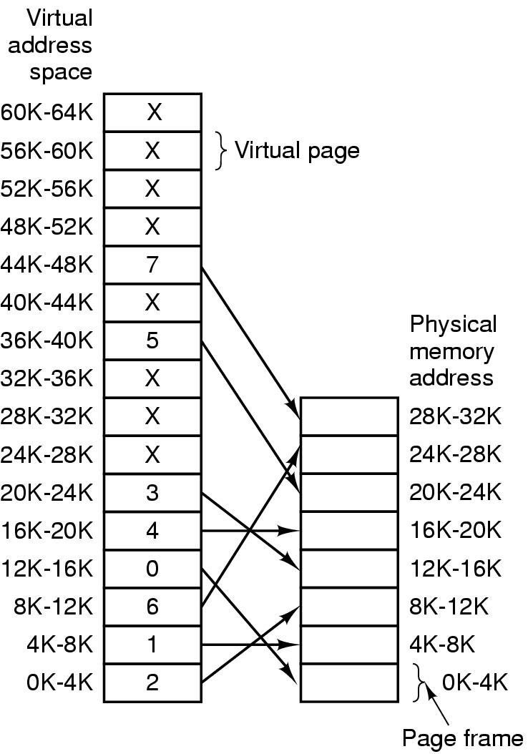
Paging
The relation between
virtual addresses and
physical memory
addresses given by page
table

Slide 47
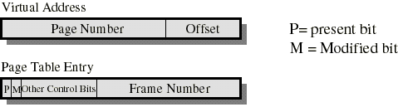
Paging
Typically, each process has its own page table
Each page table entry contains a present bit to indicate whether the page is in main memory or not.
  If it is in main memory, the entry contains the frame number of the corresponding page in main memory
  If it is not in main memory, the entry may contain the address of that page on disk or the page number may be used to index another table (often in the PCB) to obtain the address of that page on disk

Slide 48
Paging
A modified bit indicates if the page has been altered since it was last loaded into main memory
  If no change has been made, the page does not have to be written to the disk when it needs to be swapped out
Other control bits may be present if protection is managed at the page level
  a read-only/read-write bit
  protection level bit: kernel page or user page (more bits are used when the processor supports more than 2 protection levels)

Slide 49
Page Table Structure
Page tables are variable in length (depends on process size)
  then must be in main memory instead of registers
A single register holds the starting physical address of the page table of the currently running process

Slide 50
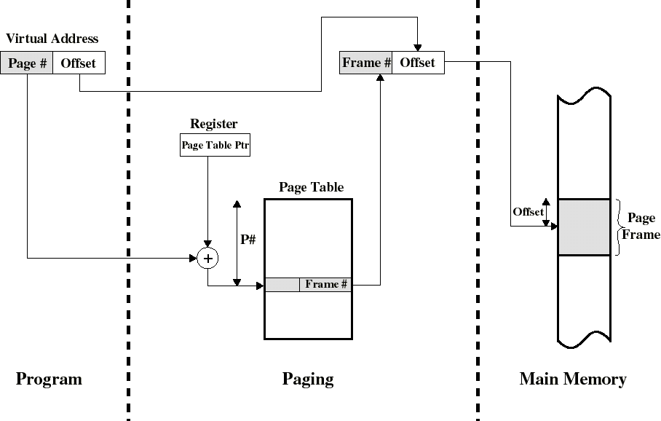
Address Translation in a Paging System

Slide 51
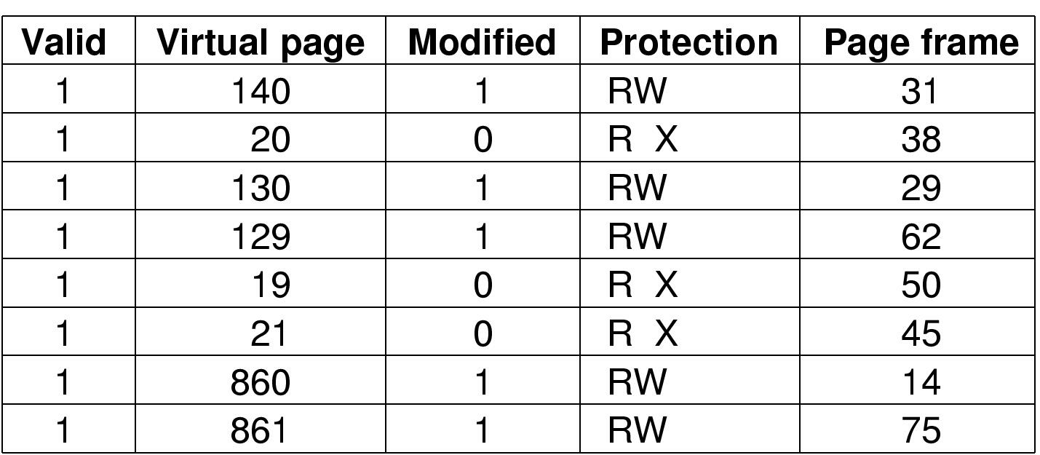
TLBs – Translation Lookaside Buffers
A TLB to speed up paging

Slide 52
Translation Lookaside Buffer
Because the page table is in main memory, each virtual memory reference causes at least two physical memory accesses
  one to fetch the page table entry
  one to fetch the data
To overcome this problem a special cache is set up for page table entries
  called the TLB - Translation Lookaside Buffer
    Contains page table entries that have been most recently used
    Works similar to main memory cache

Slide 53
Translation Lookaside Buffer
Given a logical address, the processor examines the TLB
If page table entry is present (a hit), the frame number is retrieved and the real (physical) address is formed
If page table entry is not found in the TLB (a miss), the page number is used to index the process page table
  if present bit is set then the corresponding frame is accessed
  if not, a page fault is issued to bring in the referenced page in main memory
The TLB is updated to include the new page entry

Slide 54
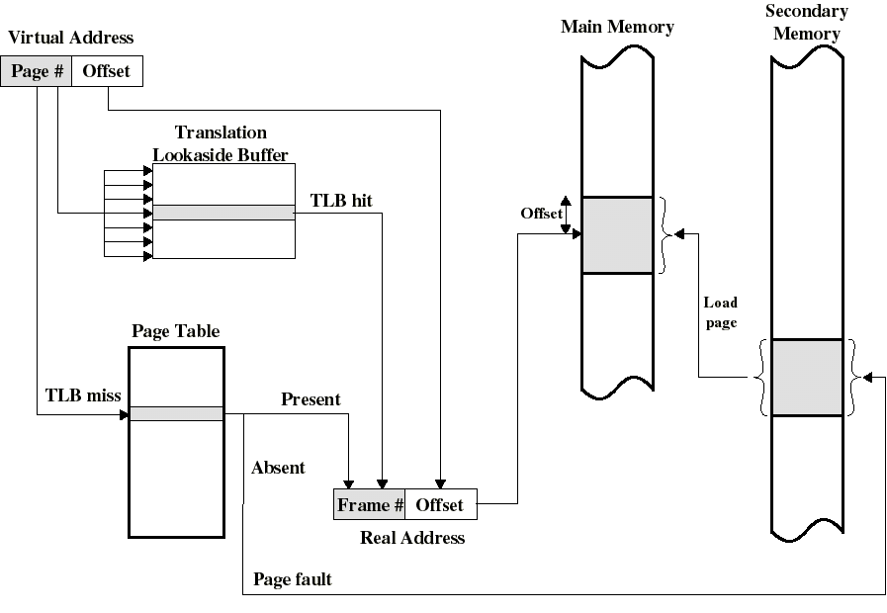
Use of a Translation Lookaside Buffer

Slide 55
TLB: further comments
TLB use associative mapping hardware to simultaneously interrogates all TLB entries to find a match on page number
The TLB must be flushed each time a new process enters the Running state
The CPU uses two levels of cache on each virtual memory reference
  first the TLB: to convert the logical address to the physical address
  once the physical address is formed, the CPU then looks in the cache for the referenced word

Slide 56
Page Replacement Algorithms
Page fault forces choice
  which page must be removed
  make room for incoming page
Modified page must first be saved
  unmodified just overwritten
Better not to choose an often used page
  will probably need to be brought back in soon

Slide 57
Optimal Page Replacement Algorithm
Replace page needed at the farthest point in future
  Optimal but unrealizable
Estimate by …
  logging page use on previous runs of process
  although this is impractical

Slide 58
Not Recently Used Page Replacement Algorithm
Each page has Reference bit, Modified bit
  bits are set when page is referenced, modified
Pages are classified
  not referenced, not modified
  not referenced, modified
  referenced, not modified
  referenced, modified
NRU removes page at random
  from lowest numbered non empty class

Slide 59
FIFO Page Replacement Algorithm
Maintain a linked list of all pages
  in order they came into memory
Page at beginning of list is replaced
Disadvantage
  Highly used page may be a victim

Slide 60
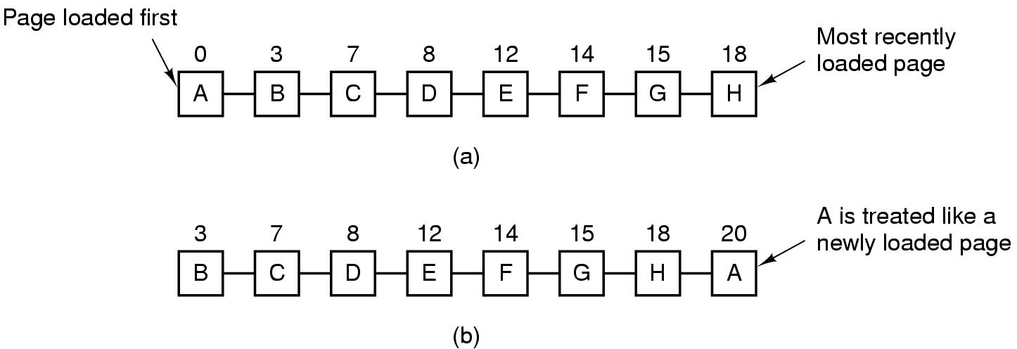
Second Chance Page Replacement Algorithm
Operation of a second chance
  pages sorted in FIFO order
  Page list if fault occurs at time 20, A has R bit set
  (numbers above pages are loading times)

Slide 61
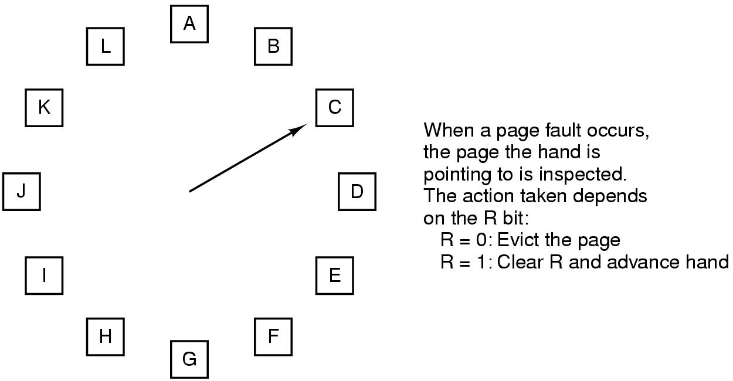
The Clock Page Replacement Algorithm

Slide 62
Least Recently Used (LRU)
Assume pages used recently will used again soon
  throw out page that has been unused for longest time
Must keep a linked list of pages
  most recently used at front, least at rear
  update this list every memory reference !!
Alternatively keep counter in each page table entry
  choose page with lowest value counter
  periodically zero the counter

Slide 63
Page Size
Small page size
Advantages
  less internal fragmentation
  less unused program in memory
Disadvantages
  programs need many pages, larger page tables

Slide 64
Page Fault Handling
1. Hardware traps to kernel
2. OS determines which virtual page needed
3. Save registers
4. OS checks validity of address, seeks page frame
5. If selected frame is dirty, write it to disk

Slide 65
Page Fault Handling
6. OS brings new page in memory from disk
7. Page tables updated
8. Faulting instruction backed up to when it began
9. Faulting process scheduled
10. Registers restored
11. Program continues

Slide 66
Q & A

